Slide 1
Legal, production and organizational structure of enterprise management
Theme 2

Slide 2
1 CLASSIFICATION OF ENTERPRISES BY ORGANIZATIONAL AND LEGAL SIGNS
A joint-stock company (JSC) is a voluntary association of funds of individuals and legal entities - shareholders, each of which bears material responsibility for the results of the joint-stock company activity within the nominal value of the shares owned by him, the total value of which forms the authorized capital of the joint-stock company. The general meeting of shareholders, being the supreme governing body of a joint-stock company, makes decisions on approving amendments to the charter, elects the board of directors of the company.
A partnership is a legal entity created as a voluntary association for any commercial purpose. Members of a limited liability partnership (LLP) are responsible for its obligations only within the limits of the contribution made by them to the charter fund of the partnership, and the members of the partnership with full responsibility bear joint and several liability for the obligations of the partnership within the limits of all property belonging to them

Slide 3
Cooperatives (lat. Cooperatio - cooperation) are one of the forms of collective property, the activity of which is based mainly on the personal labor of their members. In addition, the members of the cooperative can contribute cash and material shares to its statutory fund, in connection with which the distribution of income between the members of the cooperative can be carried out not only taking into account the personal labor contribution, but also taking into account the size of the share contributions.
A corporation is a joint stock company that brings together the activities of several firms to achieve their common goals or protect privileges. As a legal entity, a corporation is liable for debts and taxes for all its enterprises and acts as an independent business entity.
Business associations - contractual associations of enterprises and organizations created for the joint performance of homogeneous functions and coordination of common activities. Associations are associations based on membership. At the same time, the members of the association retain their legal independence, however, they bear subsidiary responsibility for its obligations. The supreme governing body of the Association is the General Meeting of Members.
Concerns are a form of contractual large associations, usually of a monopoly type, which makes it possible to use the possibilities of large-scale production, combination, cooperation, due to the presence of production and technological ties.

Slide 4
Holding companies (holding companies) are characterized by the fact that they have control over other companies either through the ownership of their shares and money capital, or in connection with the right to appoint directors of controlled companies.
A consortium is a temporary voluntary association of enterprises, organizations, formed to solve specific tasks and problems, to implement large investment, scientific and technical, social, and environmental projects. The consortium can include both large and small enterprises wishing to take part in the implementation of a project or other entrepreneurial idea, but do not have independent capabilities for its implementation..

Slide 5
2 The production structure of an enterprise is understood as the composition of its constituent sections, workshops and services, the forms of their relationship in the production process. The main elements of the production structure of the enterprise are workplaces, sites and workshops.
A workplace is an organizationally indivisible link in the production process, served by one or more workers, designed to perform a certain production or service operation (or a group of them), equipped with appropriate equipment and organizational and technical means.
The workplace can be simple and complex.
The workplace can be stationary and mobile
Production Site - a production unit that unites a number of workplaces, grouped according to certain criteria, carrying out part of the general production process for the manufacture of products or maintenance of the production process

Slide 6
The workshop is the most complex system that is part of the production structure, which includes production sites and a number of functional bodies as subsystems. Complex relationships arise in the workshop: it is characterized by a rather complex structure and organization with developed internal and external relationships.
Workshops of the enterprise can be organized according to:
technological
subject
mixed types.
Workshops by type of work:
the main production - workshops that manufacture the main products of the enterprise.
Outlet workshops (подсобные) - workshops that extract and process auxiliary materials
auxiliary workshops (вспомогательные)- manufacturing of tooling for production workshops of the enterprise, production of spare parts for factory equipment and energy resources
service shops - providing all parts of the enterprise with various types of services: instrumental, repair, energy, transport, warehouse, etc.

Slide 7
Факторы, влияющие на производственную структуру
Общеструктурные (народнохозяйственные)
К их числу относятся: состав отраслей хозяйства, соотношение между ними, степень их дифференциации, предполагаемые темпы роста производительности, внешнеторговые связи и т.п.
К числу отраслевых факторов относятся: широта специализации отрасли, обеспеченность отрасли услугами других отраслей.
Региональные факторы определяют обеспеченность предприятия различными коммуникациями: - газо- и водопроводами, транспортными магистралями, средствами связи и т.п.
Внутренние факторы :
- характер продукции и методы ее изготовления;
- объем выпуска продукции и ее трудоемкость;
- степень развития специализации и кооперации;
- мощность и особенности организации транспорта;
-оптимальные размеры подразделений, обеспечивающих управляемость ими с наибольшей эффективностью;
- специфика принимаемой рабочей силы;
- степень развития информационных систем и т.п

Slide 8
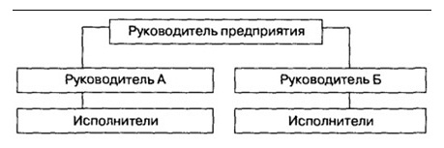
3. Organizational structure of enterprise management
The organizational structure of enterprise management is understood as the composition of departments, services and divisions in the management apparatus, the nature of subordination and accountability to each other and to the top management body of the company, as well as the procedure for the distribution of management functions across various levels and divisions of the management hierarchy..
There are the following types of organizational structures
Linear structure of enterprise management
It implies that each department is headed by a manager who exercises sole leadership of subordinate employees and who concentrates all management functions in himself. This manager, in turn, is subordinate to the superior manager.

Slide 9
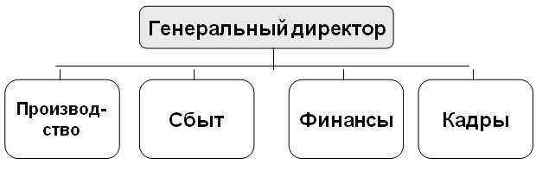
Functional - a type of organizational structure that involves the grouping of specific positions into departments based on common activities.

Slide 10
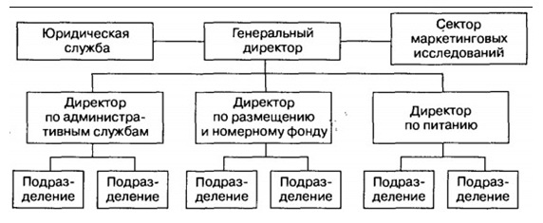
The linear-functional structure largely eliminates the shortcomings of both functional and linear types of control. With this structure, the purpose of functional services is to train data managers for line managers so that they, in turn, can make competent decisions.

Slide 11
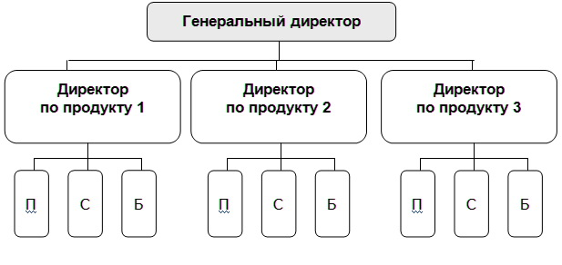
The divisional management structure implies that the criteria for grouping positions into divisions (departments) are the types of products manufactured by the enterprise, consumer groups or regions.

Slide 12
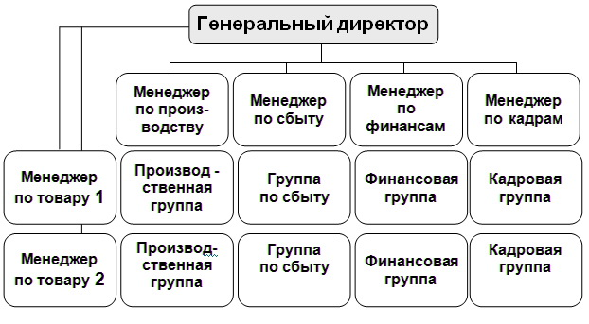
The matrix structure assumes the simultaneous grouping at one level of management according to several criteria.

Slide 13
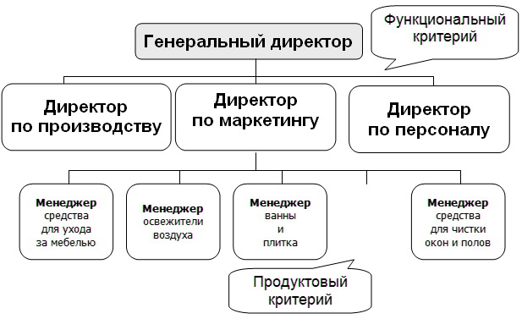
Combined structure - grouping according to various criteria.

